Slide 1
Face Recognition: The Future is Now

Slide 2
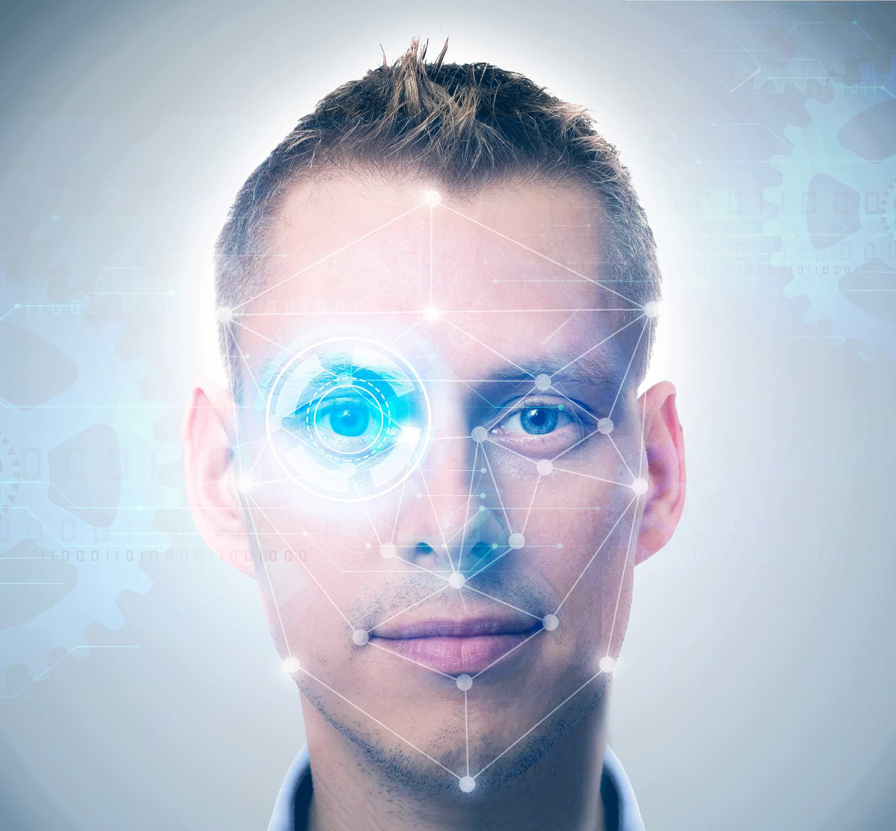
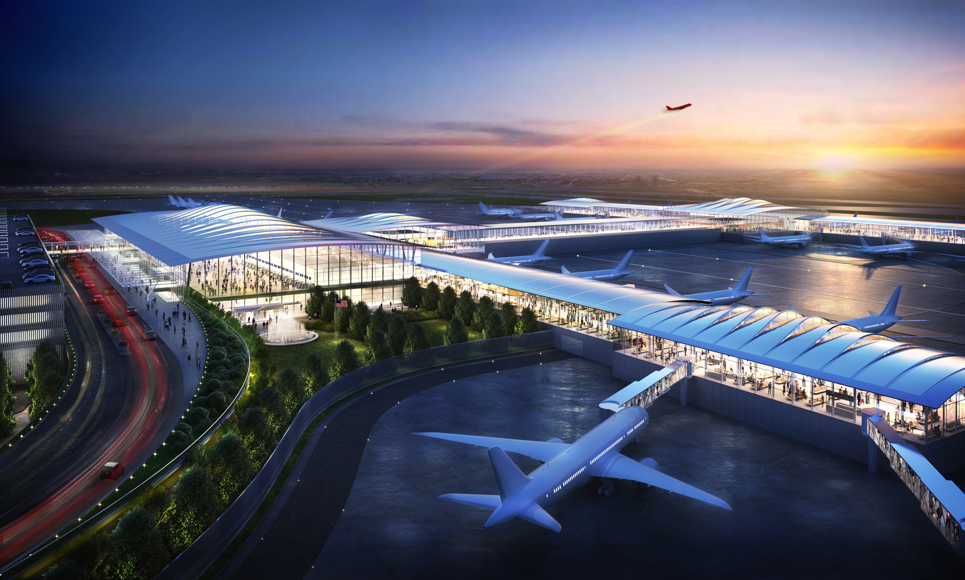
Gemalto is the Leader in Digital security
Facial recognition, also named facial biometrics, are used to establish if a person is who they say they are.
This past August, Gemalto.com explained that we recognize each other by our faces.

Slide 3
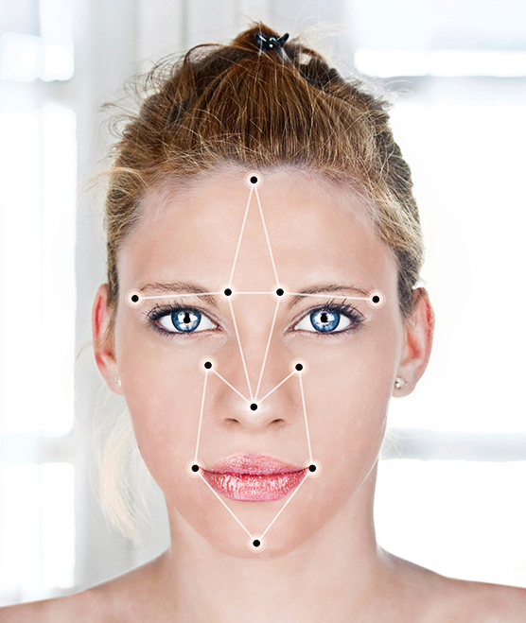
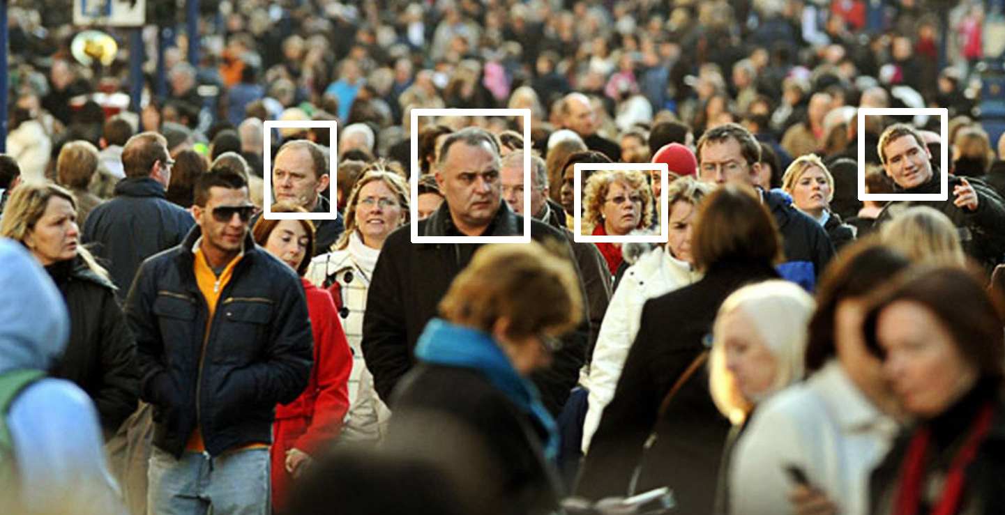
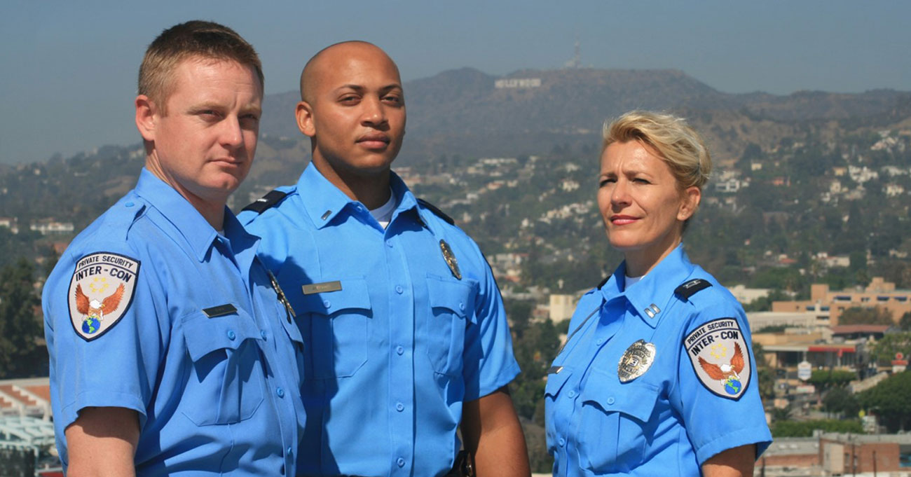
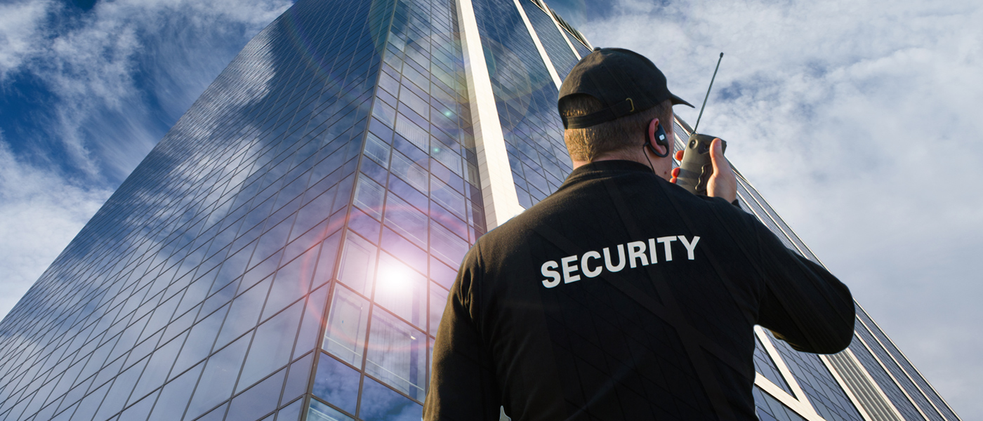
Facial Recognition Software
Combat Crime
Combat Terrorism
Protect Citizens
Security & Law Enforcement
Mary Sue Bradly. Age 23

Slide 4
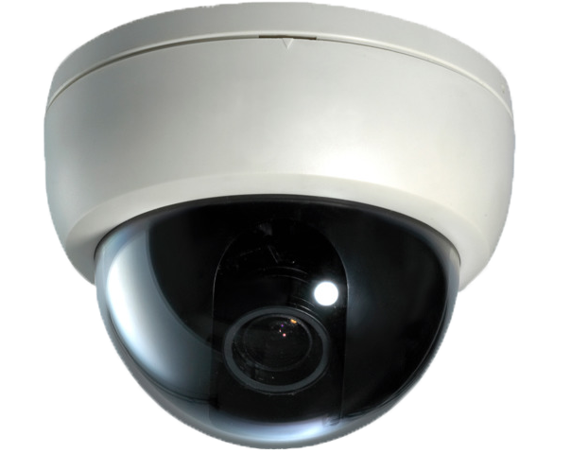
Where Else Can We Use Face Recognition?
Health Care
Taking Medicine
Pain Management
Genetic Disease
Marketing & Retail
Facebook
Saks Fifth Avenue
Watch Customers
Learn from watching
Amazon Go
KFC

Slide 5
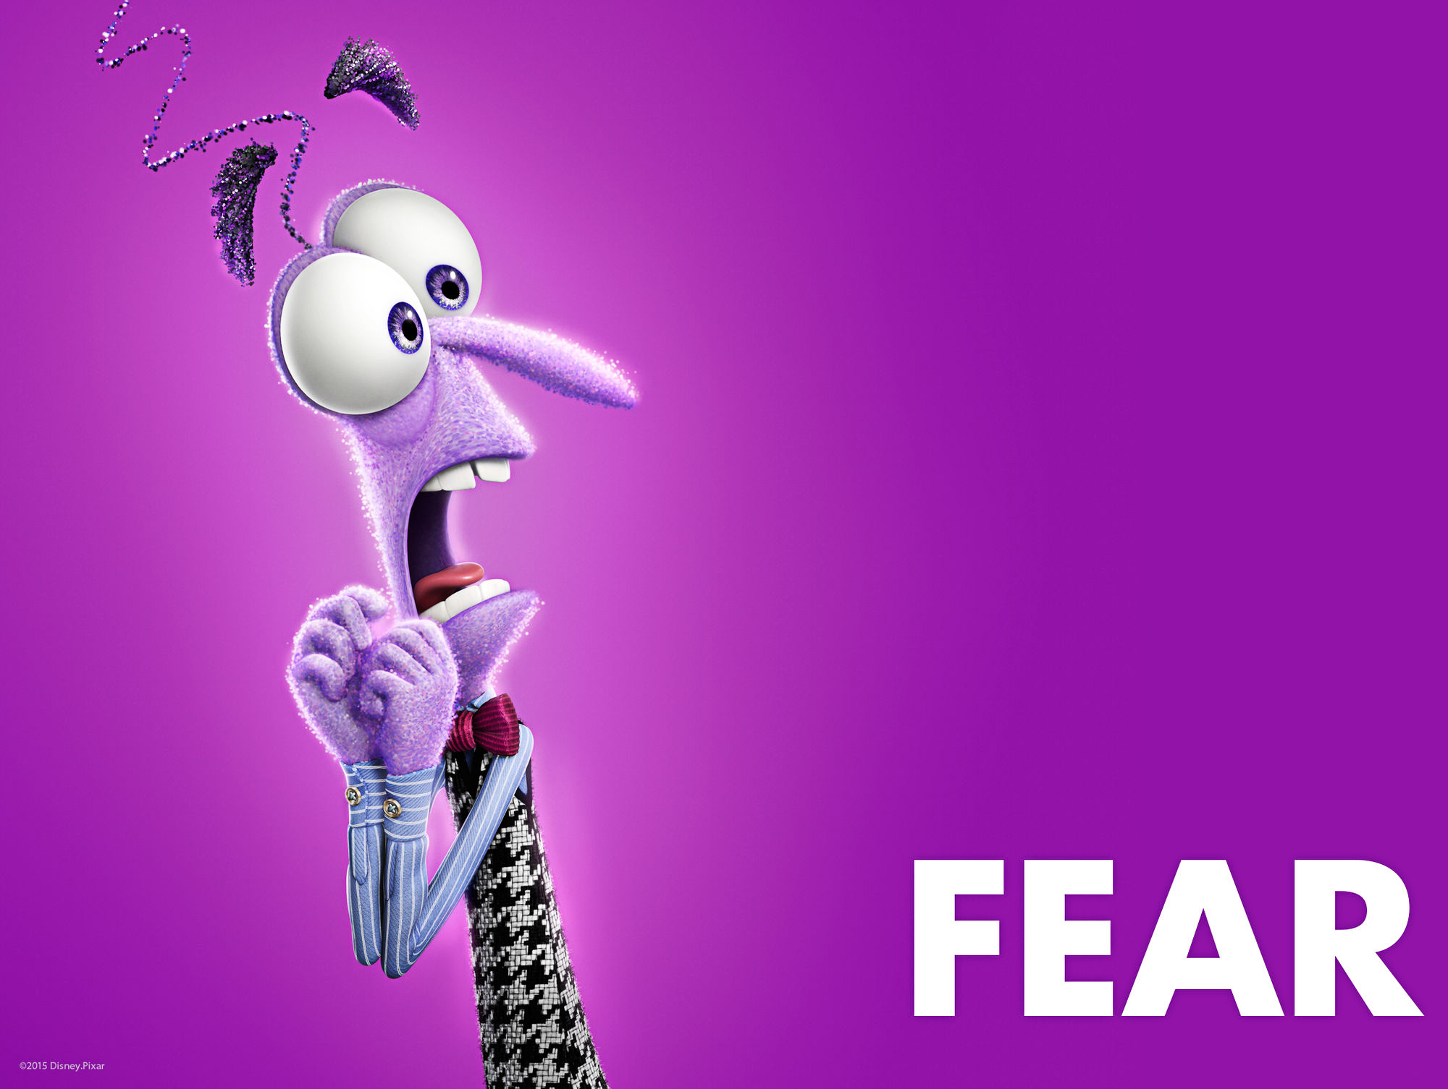
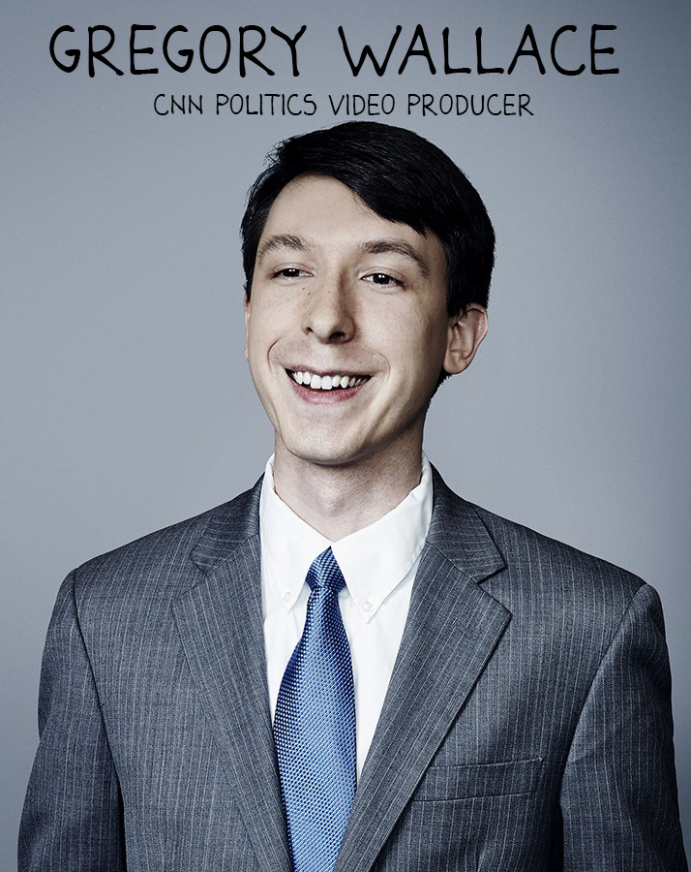
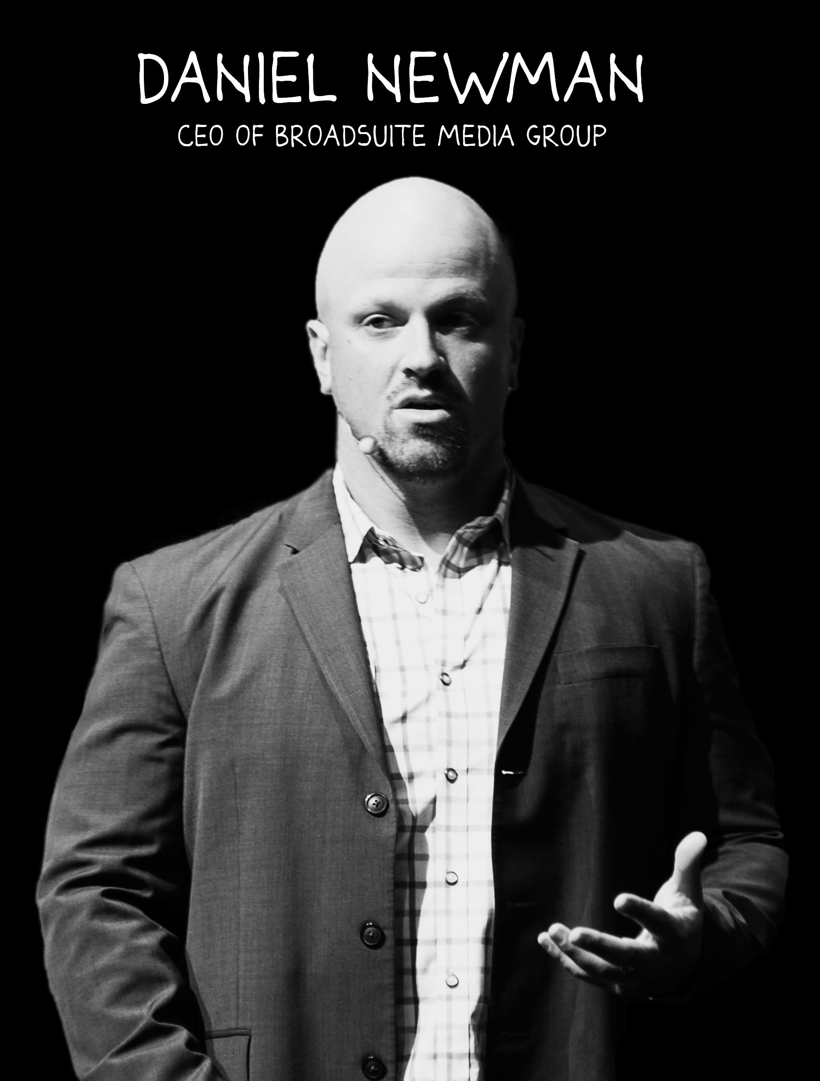
Privacy Advocates:
The American Civil Liberties Union
Expand their authority!
Amazon
Misidentified 28
Members of Congress!
Privacy
The Negatives of Face Recognition!

Slide 6
Facial Recognition
Pros
Cons
50/50

Slide 7
Thank You So Very Much!

